Slide 1
analyze “dead company dataset” by python

Slide 2
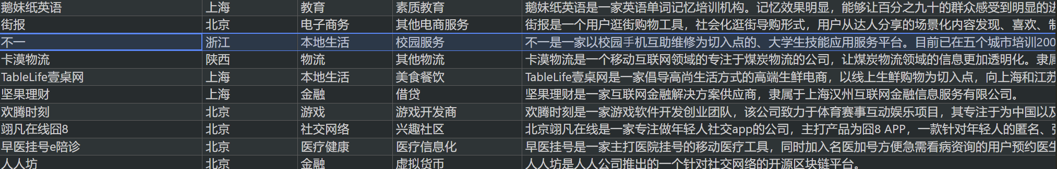
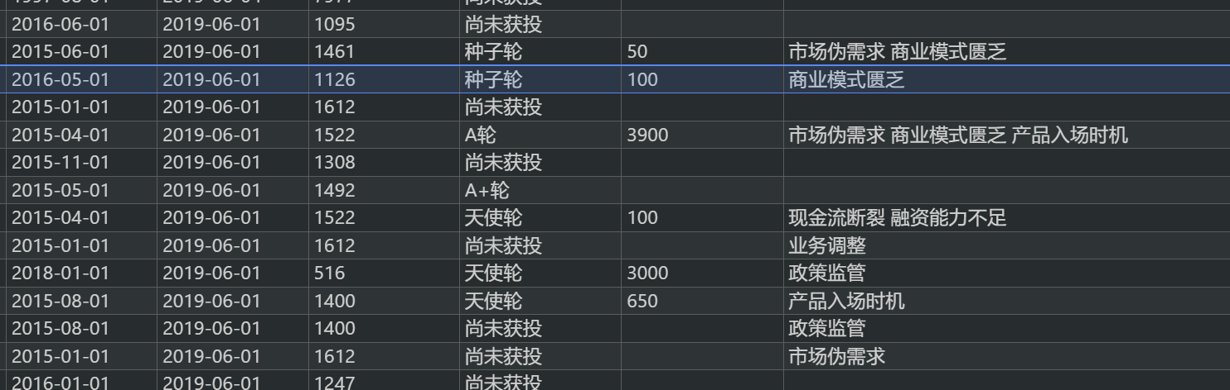
what data this dataset contain?
This is a data set of information of 6,271 dead companies.
A certain row shows that some attributes of a company.
Eg. If open dataset(by csv editor),we can find out the company’s the name, address, category, subdivision of the category, description, birthday, dead day, survive time, financing way, the total money of financing, dead reason

Slide 3
How to analyze it(Preparation)
#import library and read csv file
It is observed that the data set has empty columns, and a round of data cleaning is required first. In fact, fill in the blank with " 'unknow "
import pandas as pd
import numpy as np
import matplotlib.pyplot as plt
import seaborn as sns
#read dataset
data = pd.read_csv(r“datasetpath/ dead company dataset .csv")
#data cleaning
data = data.dropna(axis=1,how='all')
data = data.drop('bianh',axis=1)
data['se_cat'].fillna('unknow',inplace=True)
data['com_des'].fillna('unknow',inplace=True)
data['total_money'].fillna('0',inplace=True)
data['death_reason'].fillna('unknow',inplace=True)
data['invest_name'].fillna('unknow',inplace=True)
data['ceo_name'].fillna('unknow',inplace=True)
data['ceo_des'].fillna('unknow',inplace=True)
data['ceo_per_des'].fillna('unknow',inplace=True)
If there is no data cleaning, the length of the matrix is different. According to the code applying this program, it will eventually fail to run.

Slide 4
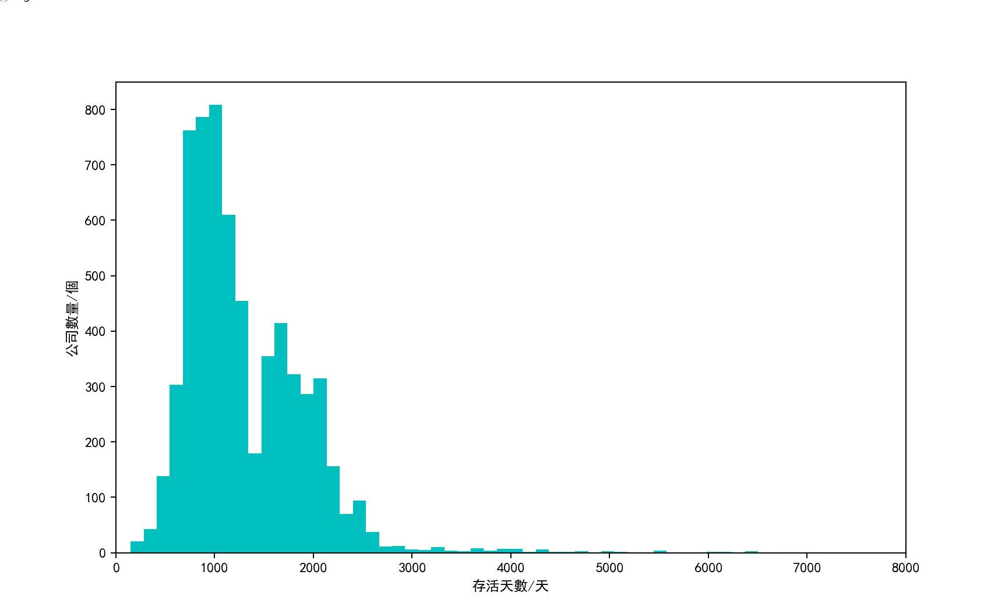
Draw a histogram by survival time
# 頻率直方圖
# data.sort_values(by ='live_days',ascending=False).head()
plt.figure(figsize=(10,6))
plt.hist(data.live_days,bins=100,color='c')
plt.xlim(0, 8000)
plt.xlabel('存活天數/天')
plt.ylabel('公司數量/個')
Result:
Years 3(1000 day) and 7 (2500 day)
of a large number
of company “dead”

Slide 5
Industry Distribution Pie Chart
death_x = death_rs.value_counts().index
death_y = death_rs.value_counts().values
plt.figure(figsize=(10,6))
plt.xticks(rotation=-60)
plt.bar(death_x[0:15],death_y[0:15],align='center',color='c')
plt.xlabel('公司死亡原因')
plt.ylabel('數量/個')
plt.figure(figsize=(10,6))
data.cat.value_counts().plot.pie(autopct="%1.1f%%")
death_rs =[]
for death_r in data['death_reason']:
if death_r != 'unknow':
death_rs.extend(death_r.split(' '))
else:
continue
death_rs = pd.Series(data=death_rs)

Slide 6
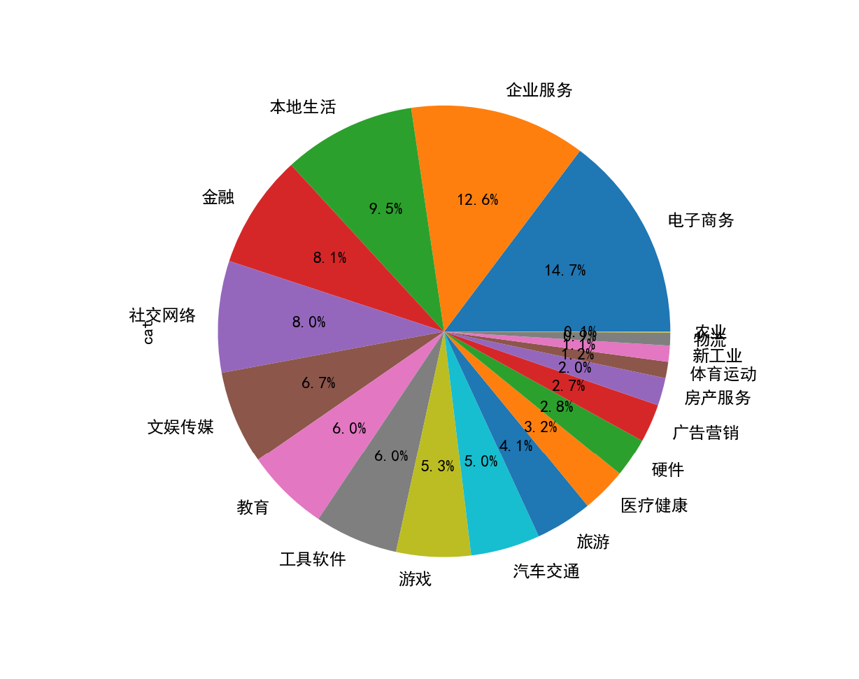
Result:
E-commerce and enterprise services are the industries
with the most distribution among dead companies

Slide 7
Analyze the relationship between survival time and other characteristics heatmap display
# comany_address
scaleronehot3=preprocessing.OneHotEncoder().fit(np.array(data.com_addr.value_counts().index).reshape(-1, 1))
data4=pd.DataFrame(scaleronehot3.transform(np.array(data.com_addr).reshape(-1, 1)).toarray(),columns=range(35,72))
data5=pd.concat([data2,data3,data4,data.live_days],axis=1)
from sklearn import preprocessing
#one-hot coding
scaleronehot=preprocessing.OneHotEncoder().fit(np.array(data.cat.value_counts().index).reshape(-1, 1))
# category
data2=pd.DataFrame(scaleronehot.transform(np.array(data.cat).reshape(-1, 1)).toarray(),columns=range(0,19))
# financing
scaleronehot2=preprocessing.OneHotEncoder().fit(np.array(data.financing.value_counts().index).reshape(-1, 1))
data3=pd.DataFrame(scaleronehot2.transform(np.array(data.financing).reshape(-1, 1)).toarray(),columns=range(19,35))
#Correlation coefficient
corr=data5.corr()
plt.figure(figsize=(10,10))
sns.heatmap(corr,cmap="BuGn")
Perform one-hot encoding on three of the label variables (category, financing way, comany_address
) int to digital data, then calculate the Correlation coefficient and draw a heat map

Slide 8
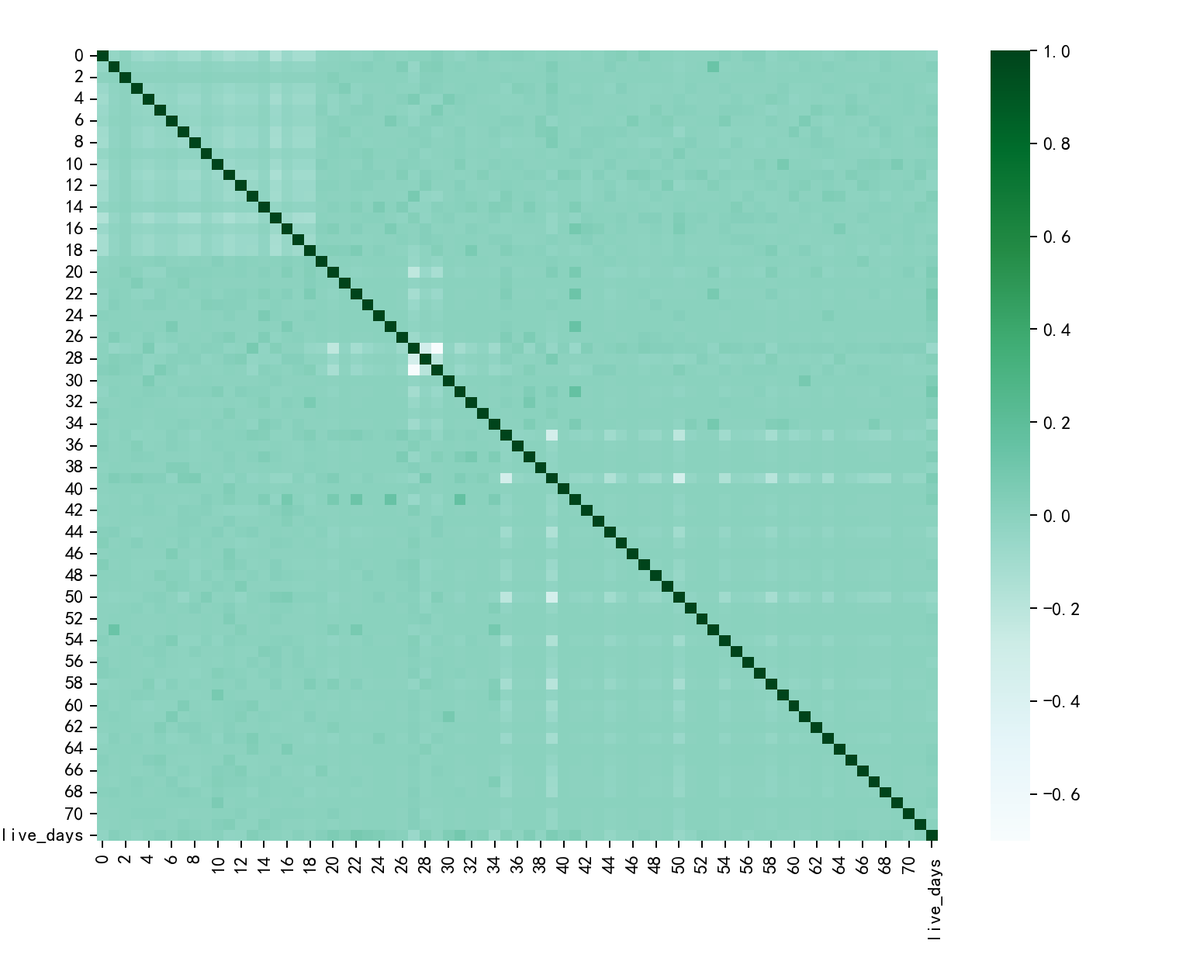




According to the program for making the heat map, each number corresponds to an attribute through one-hot encoding, which is divided into four categories, the total is 73, the specific corresponding relationship will not be shown here.
category
Financing way
comany_address
Survival days

Slide 9
There are indeed some dark spots on the heat map (the correlation coefficient is relatively large), we print out them directly
corr.live_days.sort_values()[-6:]
print(data.financing.value_counts().index[31-19])
print(data.financing.value_counts().index[22-19])
print(data.financing.value_counts().index[23-19])
print(data.com_addr.value_counts().index[39-35])
print(data.financing.value_counts().index[20-19])
B+輪
A輪
B輪
四川
未獲得投資
These attributes are positively correlated with the company's survival time

Slide 10
In fact, we can also draw some interesting conclusions from the same principle…
level=0.1
for row in range(0,72):
for column in range(0,72):
if ((corr.loc[row,column]>=level) & (corr.loc[row,column]<1)):
if(row<=18):
if(column<=18):
print(data.cat.value_counts().index[row]," : ",data.cat.value_counts().index[column]," = ",corr.loc[row,column])
elif(column<=34):
print(data.cat.value_counts().index[row]," : ",data.financing.value_counts().index[column-19]," = ",corr.loc[row,column])
elif(column>=35): …omit
# 企業服務: 香港 = 0.1335995260407172
# A輪 : 福建 = 0.12507250066324943
# 種子: 福建 = 0.14665307301514435
# B+輪 : 福建 = 0.16248528147042204
These properties are correlated (weakly correlated)

Slide 11
Through the above analysis, we can draw a rough conclusion：
If you‘re going to invest in a company, maybe…
Try to avoid companies that are in their 3th and 7th years
E-commerce and enterprise services are popular, but they are also really prone to failure
Seeing that companies have these attributes, maybe should be careful
B+輪,A輪,B輪, 未獲得投資,四川
These attributes are related in pairs in dead companies, and may represent the economic composition of the region, which is worth further studying
# 企業服務: 香港
# A輪 : 福建
# 種子: 福建
# B+輪 : 福建

